Slide 1
LHC-201 Fluid Line Routing Details
OpenAg, MIT Media Lab
By Eugene Zeleny
Oct 30th, 2019

Slide 2
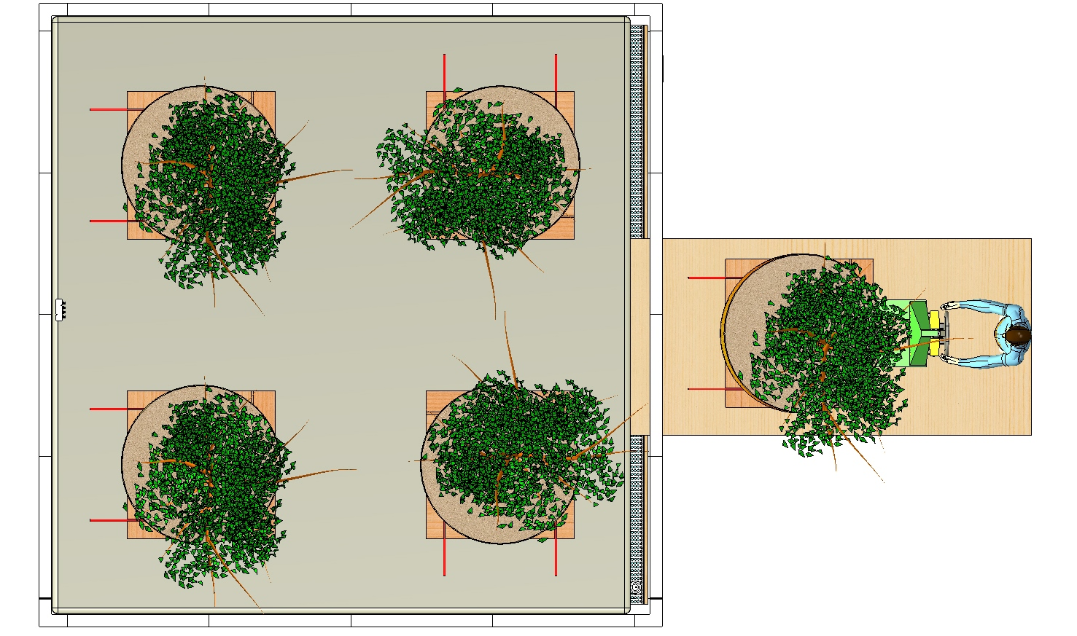
Fluid to Tree Heater
Fluid from Tree Heater
Tree pallet layout and suggested fluid line routing for the Tree Heater Assembly

Slide 3
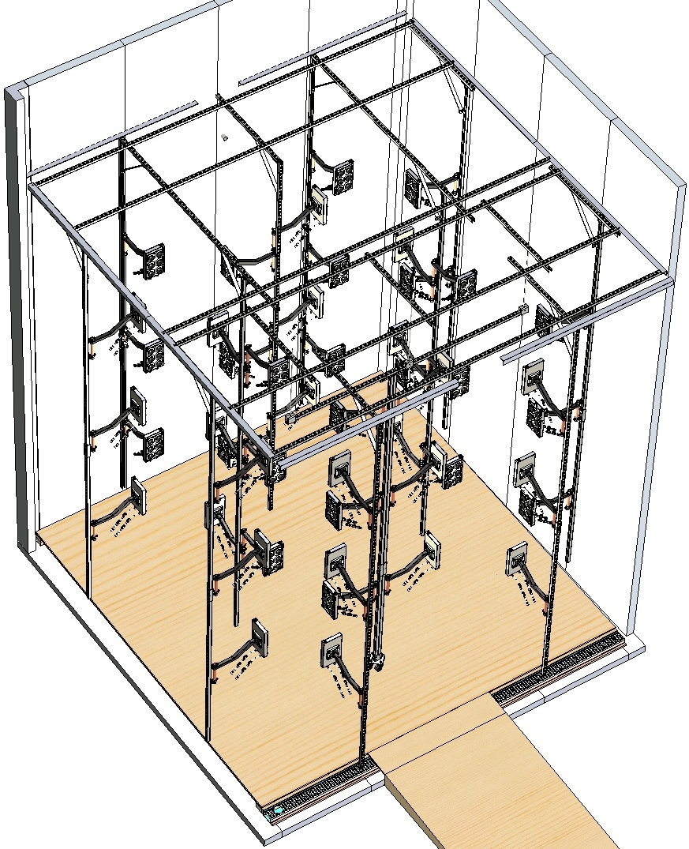
Heated Fluid
To Radiator
Cooled Fluid
To LEDs
Fluid Leaving the LEDs
Fluid Entering the LEDs
Suggested fluid line routing for LED Enclosures

